Slide 1
Linear Equations in Linear Algebra
1.3 Vector Equations
Bumhee Cho

Slide 2
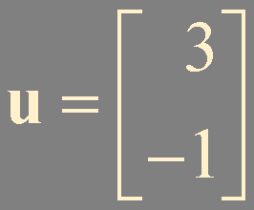
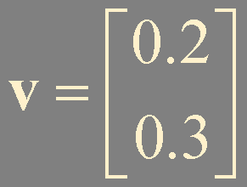
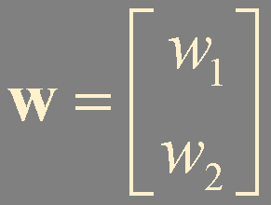








Vectors in ℝ²
Vector summation

Slide 3


Scalar multiplication

Slide 4
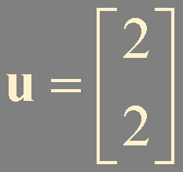
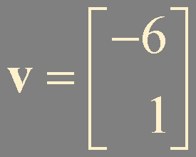
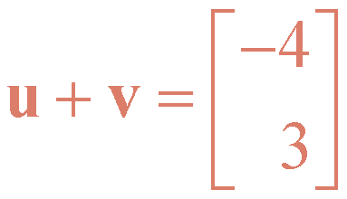
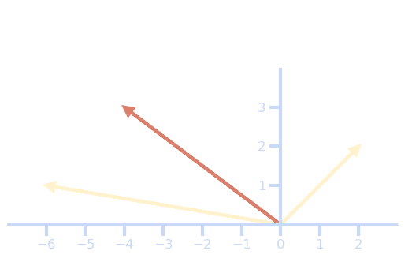





Geometric descriptions of ℝ²

Slide 5
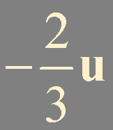

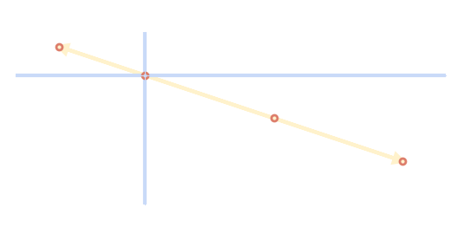
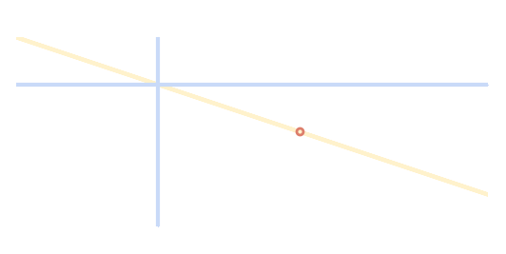


set of all multiple of

Slide 6

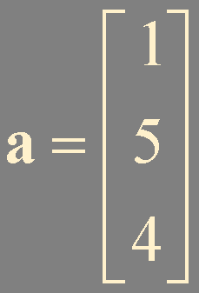


Vectors in ℝ³

Slide 7
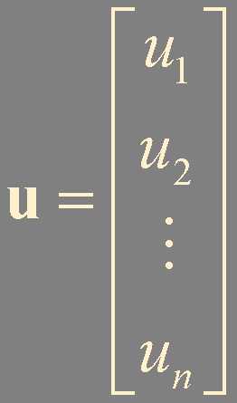

Vectors in ℝ^{n}

Slide 8














Algebraic properties of ℝ^{n}
ℝ^{n}
scalar
+

Slide 9



Linear combinations
ℝ^{n}
scalar
linear combination of
with weights

Slide 10



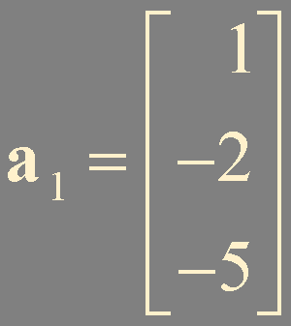
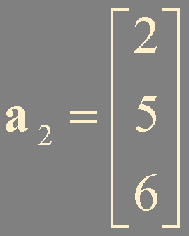
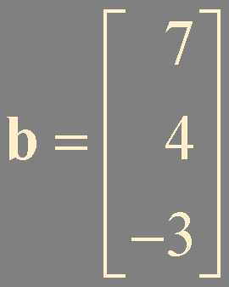


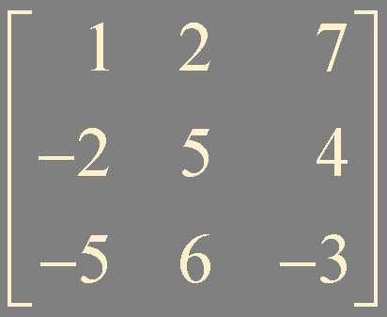
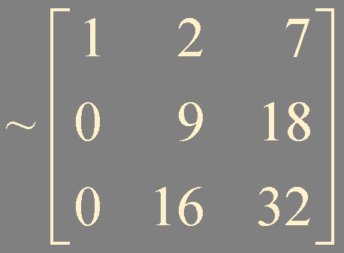
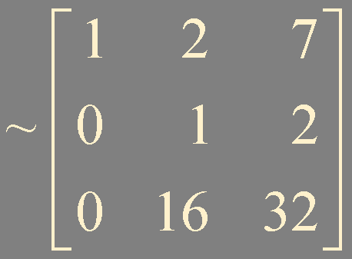
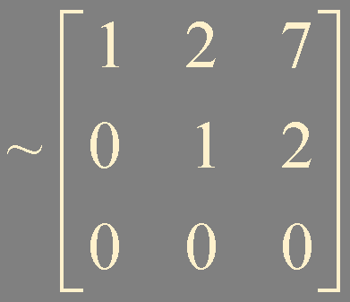
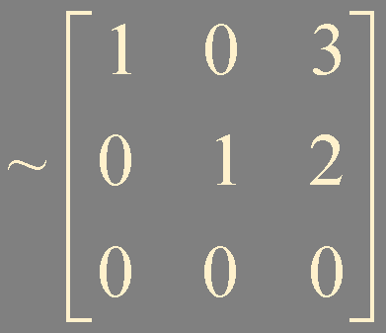
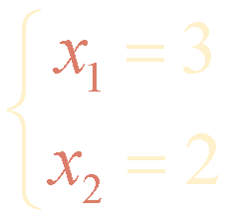
Example 1. can be generated as a linear combination of and ?

Slide 11



can be generated as a linear combination of and ?
Does the following augmented matrix have a solution?
A vector equation
has the same solution set as the linear system whose augmented matrix is

Slide 12


is the collection of all vectors that can be written in the form

Slide 13



Q1.
Does the following vector equation have a solution?
Q2.
Does the following augmented matrix have a solution?
Q3.

Slide 14







Slide 15
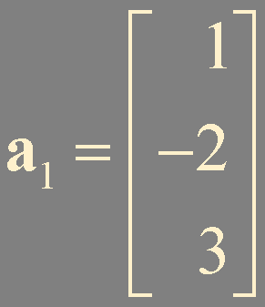
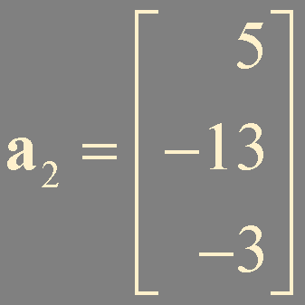
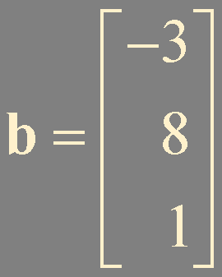
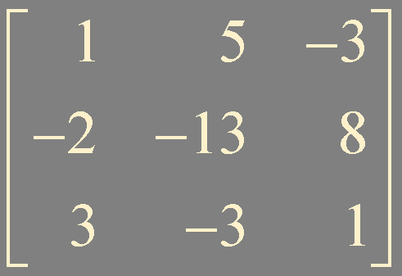
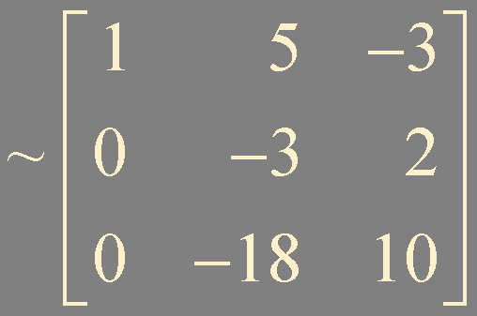
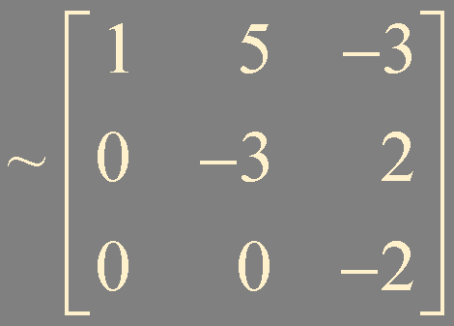
Example 2.
Theorem 2. Existence and Uniqueness Theorem
no solution (inconsistent) !

Slide 16
Summary
vectors in ℝ^{n}: algebraic properties
linear combination: vector equation
Span {}

